Slide 1
Python Epistemology
Allen B. Downey
Olin College of Engineering

Slide 2
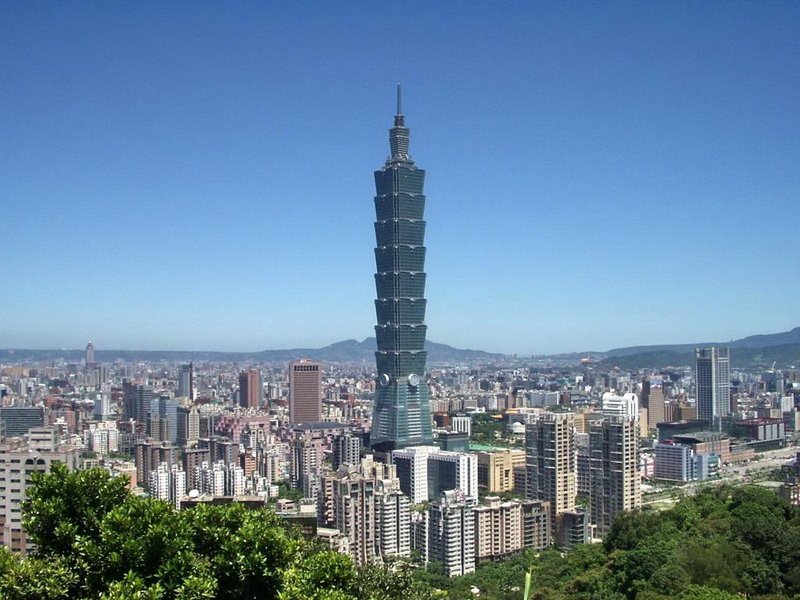
Wish I was there!

Slide 3
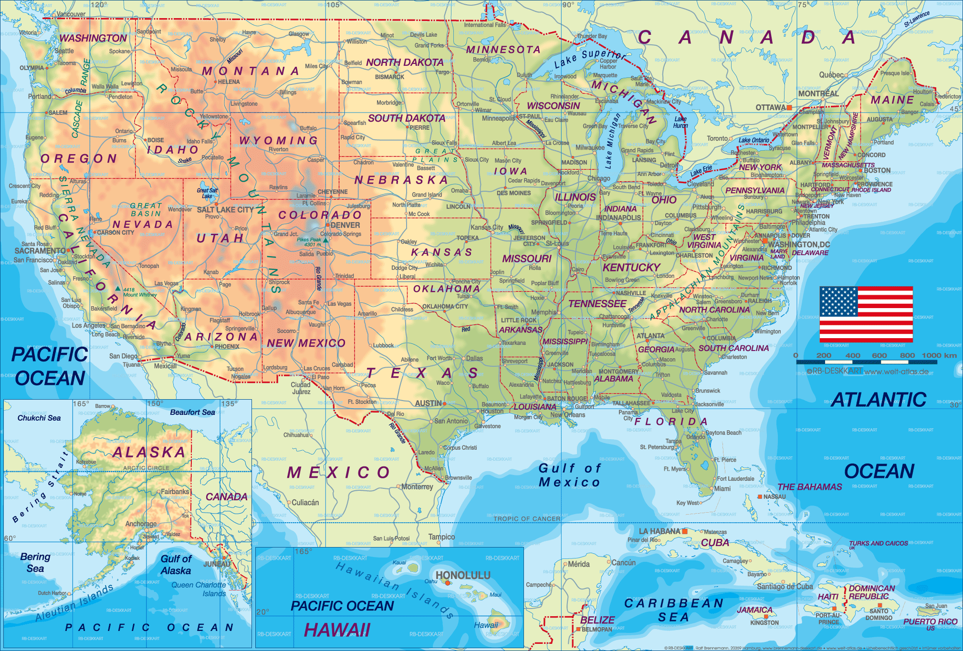
I am here

Slide 4
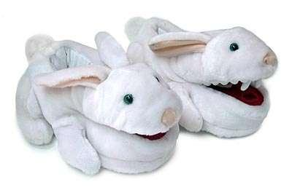
Python Epistemology
In general: Theory of knowledge. How we know what we know.
This talk: Python as a way of thinking.

Slide 5
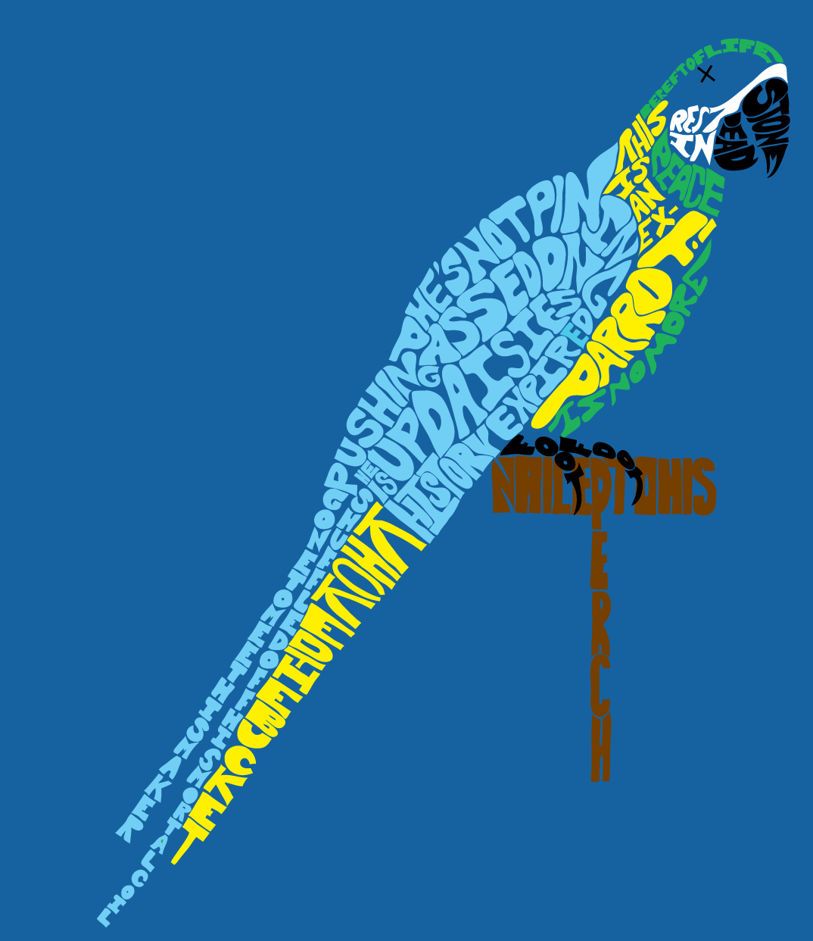
Python Epistemology
How I started using Python.
What Python has taught me.

Slide 6
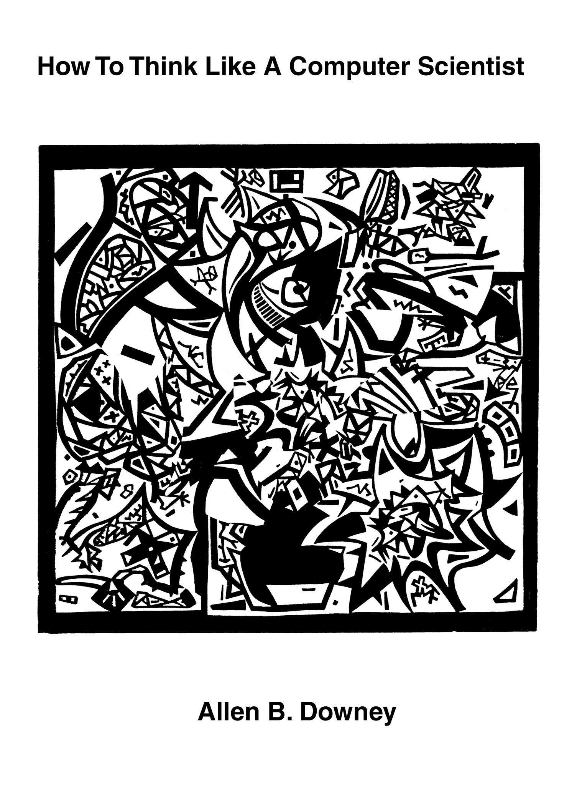
1999
Teaching in Java, needed a better book.
Wrote 140 pages in 14 days.
"Published" under a free license.

Slide 7
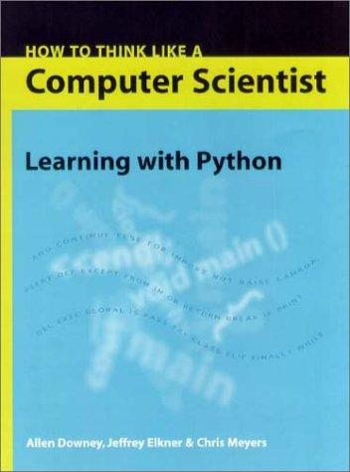
2000
Jeff Elkner translated my book into Python.
And that's how I learned Python.

Slide 8
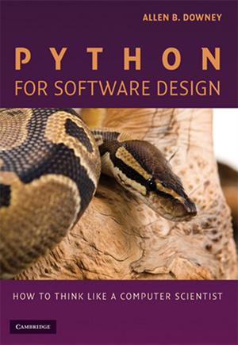
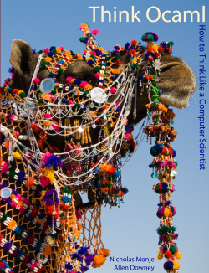
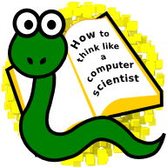
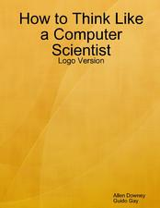
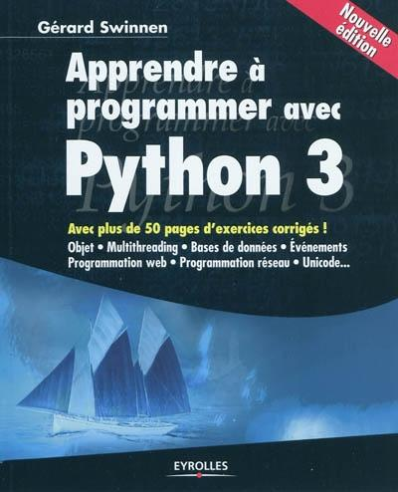
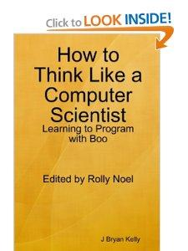
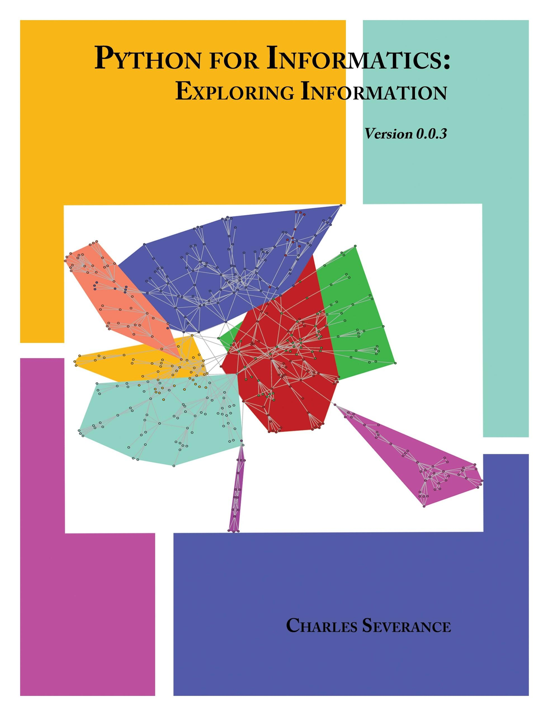
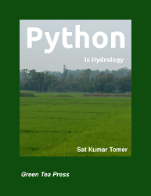
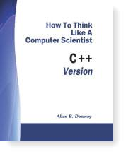
2001-2011

Slide 9
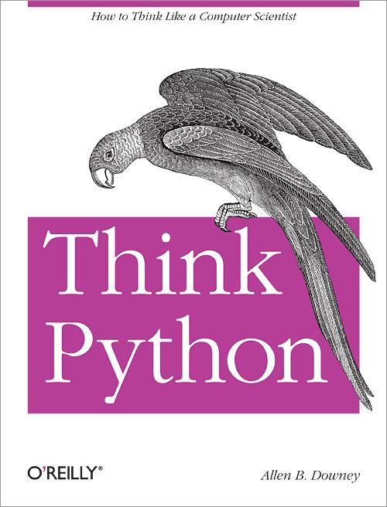
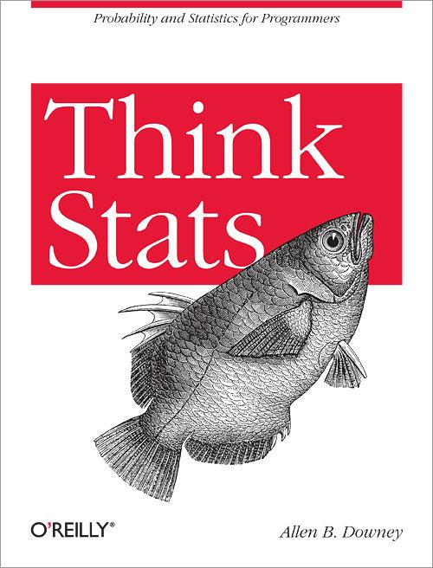
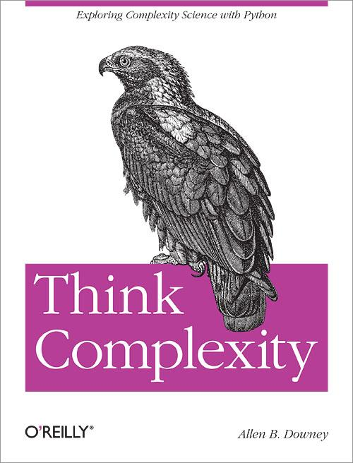
2012-2013
My project:
Think Python
Think Stats
Think Complexity
Think Bayes (coming soon)

Slide 10
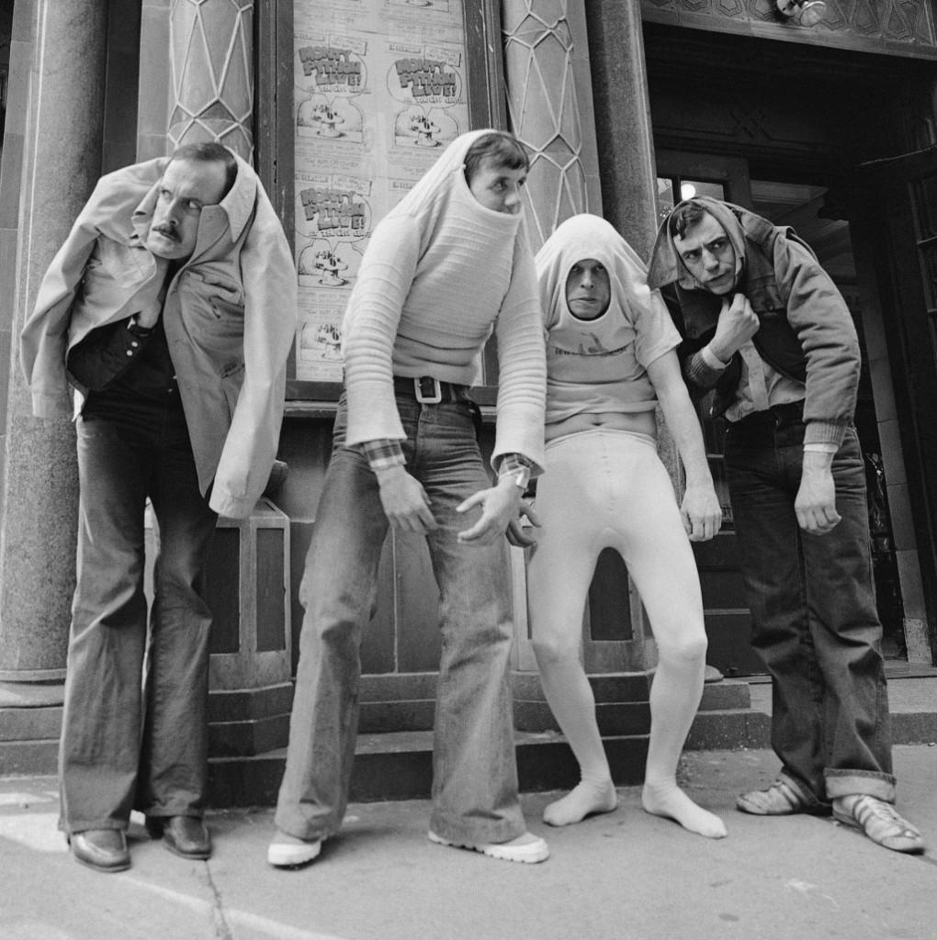
What have I learned?

Slide 11
What have I learned?
Python is named after Monty Python (the British comedy show), not the snake.

Slide 12
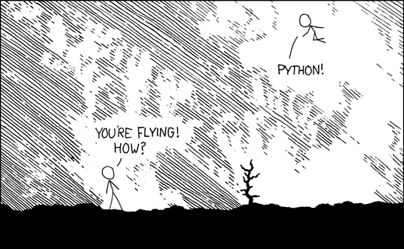
Python is my favorite language
http://xkcd.com/353/

Slide 13
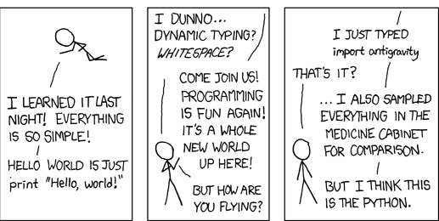
xkcd on Python

Slide 14
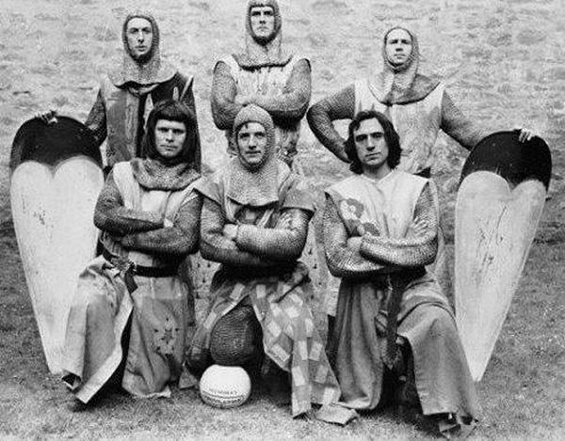
Also
Using Python has changed my ideas about what programming is.

Slide 15
Part One
Programming is not about translating a well-known solution into code, it is about discovering solutions by writing code, and then creating the language to express them.

Slide 16
Homework 1
Write a function is_anagram that takes two words and returns True if they are anagrams.
stop = pots
refragmentation = antiferromagnet

Slide 17
Anagrams
refragmentation
antiferromagnet

Slide 18
Anagrams
def is_anagram(word1, word2): t = list(word2)
for char in word1: if char not in t: return False t.remove(char) return len(t) == 0

Slide 19
Anagrams
def is_anagram(word1, word2):
return (sorted(word1) ==
sorted(word2))

Slide 20
Anagrams
from collections import Counter
def is_anagram(word1, word2):
return (Counter(word1) ==
Counter(word2))

Slide 21
Anagrams
Good solution, so far.
Concise.
Readable.
Uses built-in data structure.
Demonstrably correct.
Efficient.

Slide 22
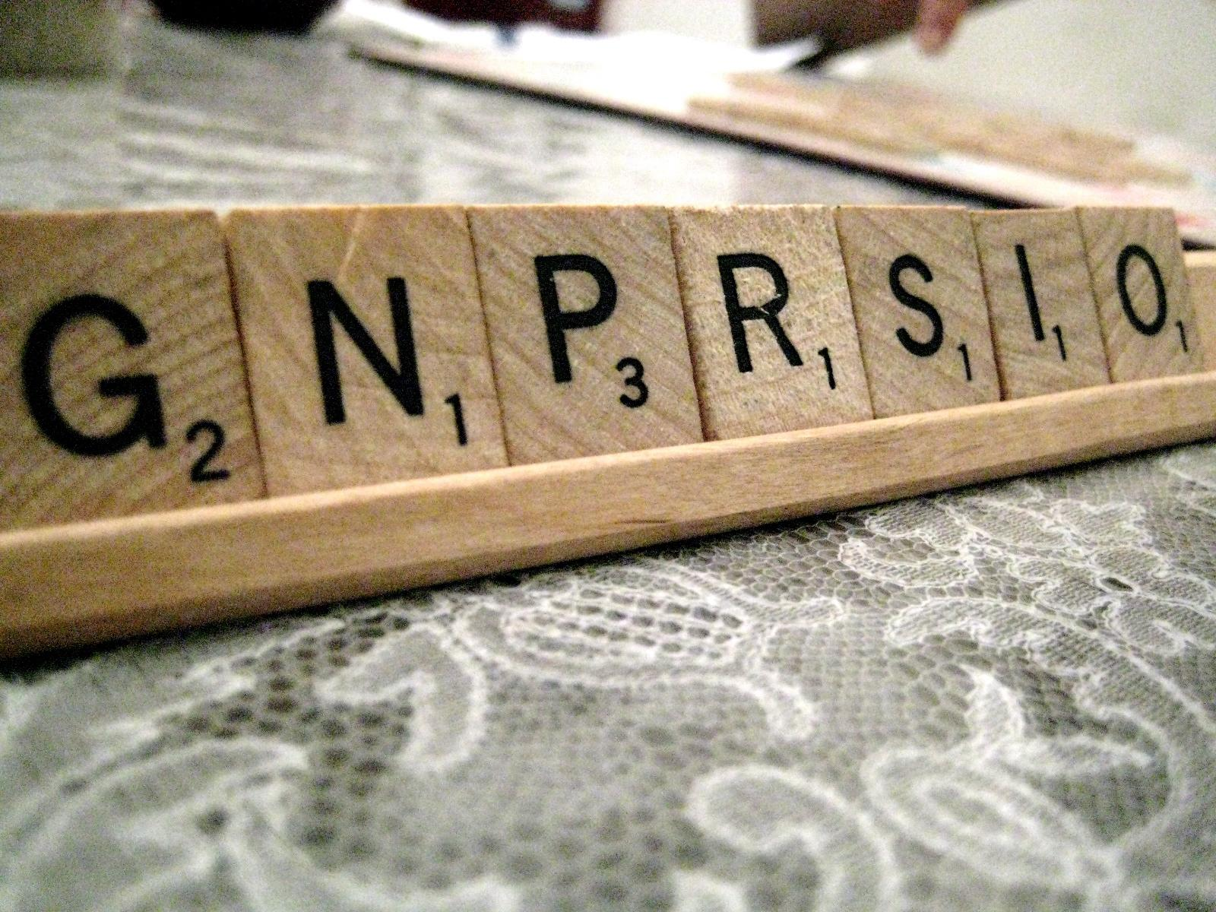
Homework 2
Write a function can_spell that takes a word and a string of "tiles" and returns True if the tiles can spell the word.
http://nepalscrabbleclub.files.wordpress.com/2011/12/rack3.jpg

Slide 23
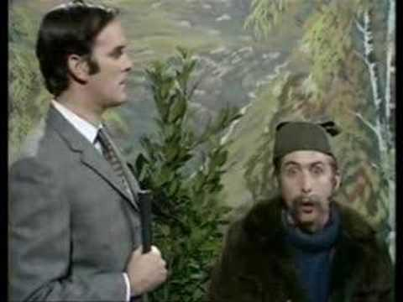
Tiles
Previous solution doesn't generalize.
But we can extend Counter.

Slide 24
Tiles
class Multiset(Counter): """A set with repeated elements.""" def is_subset(self, other):
for char, count in self.items(): if other[char] < count: return False return True

Slide 25
Tiles
def can_spell(word, tiles): return Multiset(word).is_subset(Multiset(tiles))
Is this a good solution?

Slide 26
Tiles
def can_spell(word, tiles): return Multiset(word).is_subset(Multiset(tiles))
Is this a good solution?
Readable and demonstrably correct.
Expressed in terms of a reusable abstraction.
Extensible.
Efficient.

Slide 27
Tiles
And it's an example of the idea:
Programming is not about translating a well-known solution into code, it is about discovering solutions by writing code, and then creating the vocabulary to express them.

Slide 28
Part Two
... you don't just write your program down toward the language, you also build the language up toward your program.
In the end your program will look as if the language had been designed for it. And ... you end up with code which is clear, small, and efficient.
Paul Graham, "Programming Bottom Up," 1993.

Slide 29
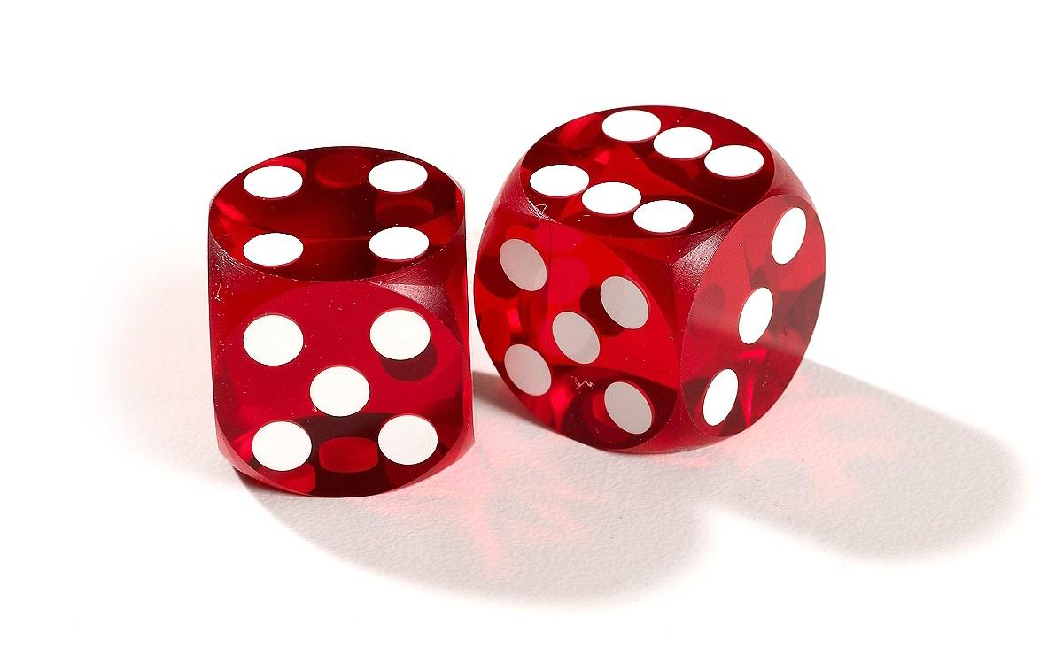
Dice

Slide 30
Pmf
PMF = Probability Mass Function.
Map from each possible result to its probability.
All probabilities from 0-1, and they add up to 1.

Slide 31
Pmf
class Pmf(Counter): """A Counter with probabilities.""" def normalize(self): total = sum(self.values()) for key in self: self[key] /= total

Slide 32
Dice
# make a Pmf to represent a die
d6 = Pmf([1,2,3,4,5,6])
d6.normalize()

Slide 33
Dice
print d6
Pmf({
1: 0.16666666666666666,
2: 0.16666666666666666,
3: 0.16666666666666666,
4: 0.16666666666666666,
5: 0.16666666666666666,
6: 0.16666666666666666})

Slide 34
Dice
class Pmf(Counter):
def __add__(self, other): pmf = Pmf()
for key1, prob1 in self.items(): for key2, prob2 in other.items(): pmf[key1 + key2] += prob1 * prob2
return pmf

Slide 35
Dice
# now the + operator works for Pmfs
d6_twice = d6 + d6

Slide 36
Dice
# and so does sum()
pmf_ident = Pmf([0])
d6_thrice = sum([d6]*3, pmf_ident)

Slide 37
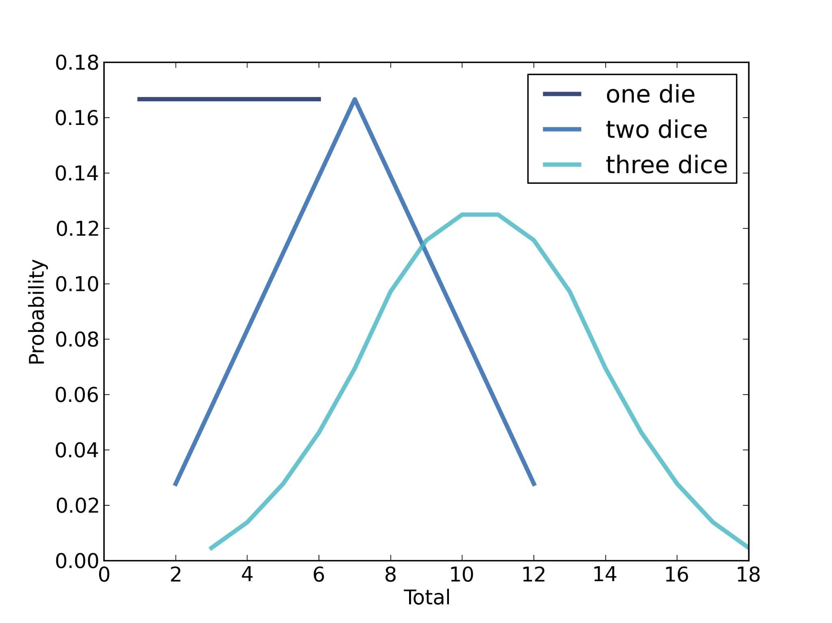
Dice

Slide 38
The point?
1) Showing off Python.
http://xkcd.com/353/

Slide 39
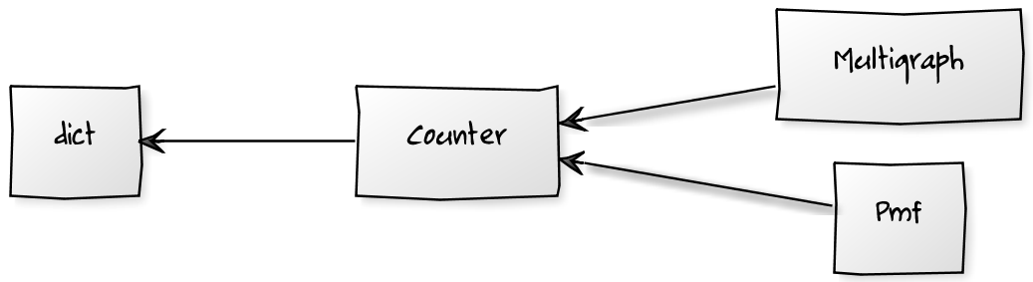
The point?
2) Underappreciated data structures.
http://yuml.me/

Slide 40
The point?
3) An example of bottom-up programming.
... you don't just write your program down toward the language, you also build the language up toward your program.
In the end your program will look as if the language had been designed for it. And ... you end up with code which is clear, small, and efficient.
Paul Graham, "Programming Bottom Up," 1993.
http://www.paulgraham.com/progbot.html

Slide 41
The point?
4) Not obvious in the final design, but...
While designing libraries for Think Stats and Think Bayes, I came to understand probability distributions.

Slide 42
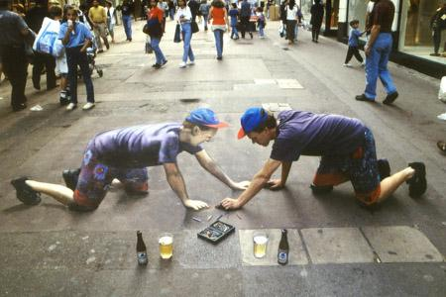
The point?
4) Programming is a way to make your understanding executable, then debug it.
Julian Beever, "Self-Portrait of the Artist with Liquid Refreshment"

Slide 43
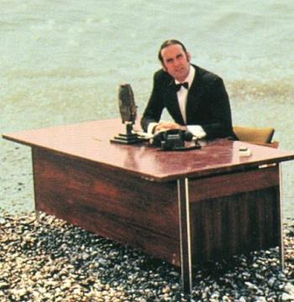
Part Three

Slide 44
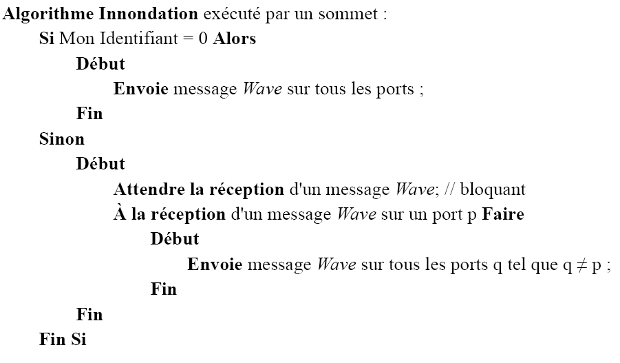
Pseudocode
What is pseudocode for?
http://upload.wikimedia.org/wikipedia/commons/5/5e/Algorithme_inondation-pseudocode.png

Slide 45
Pseudocode
What is pseudocode for?
Expressive.
Customizable.
Readable.
Concise.
But a funny thing happened...

Slide 46
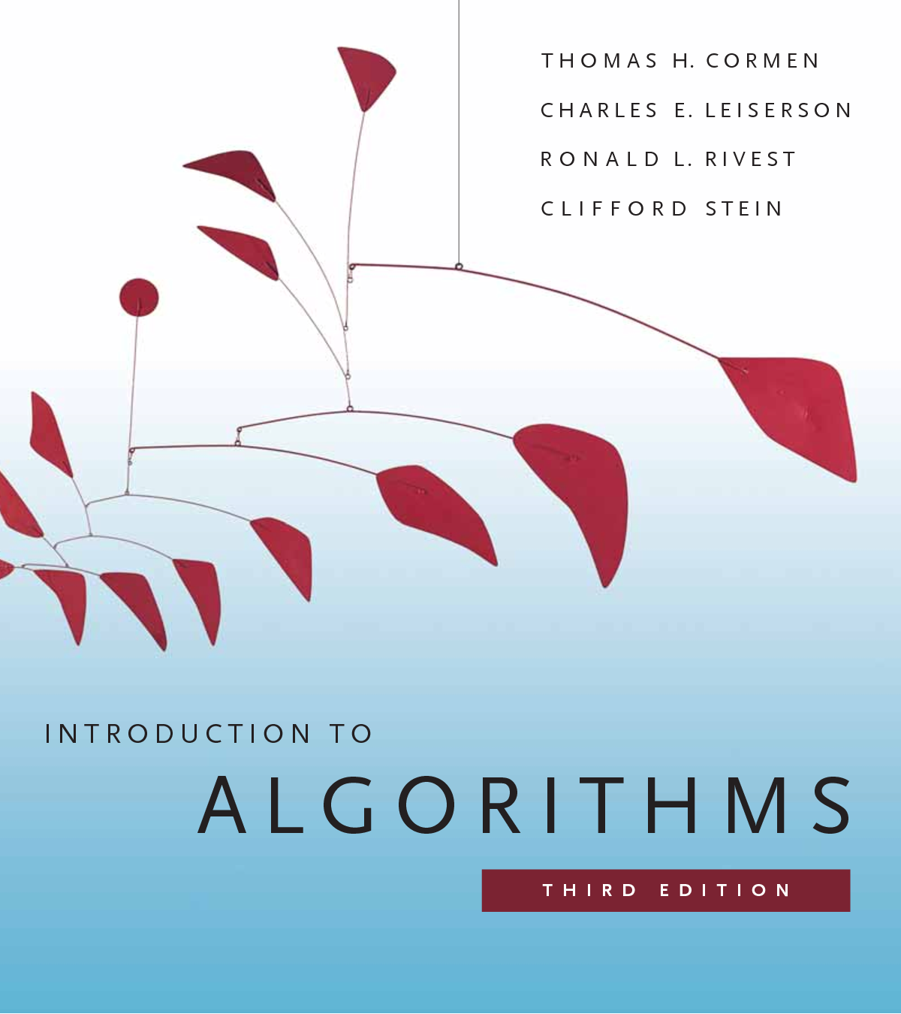
Pseudocode
I was translating pseudocode into Python.
It got smaller and more readable.

Slide 47
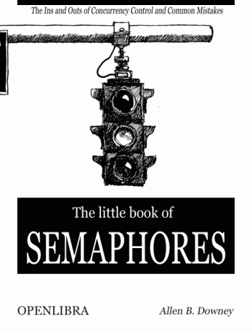
Pseudocode
Same with The Little Book of Semaphores.

Slide 48
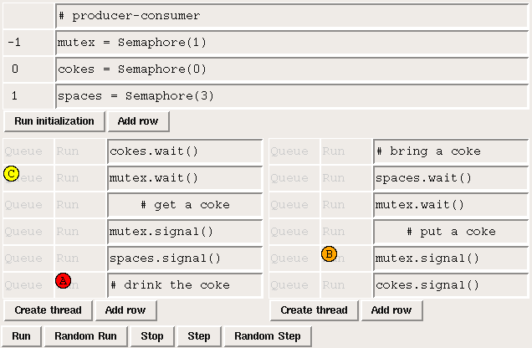
Pseudocode
Which led to Sync.

Slide 49
Programming as translation
Explore in natural language.
Solve in math notation.
Translate into a program.

Slide 50
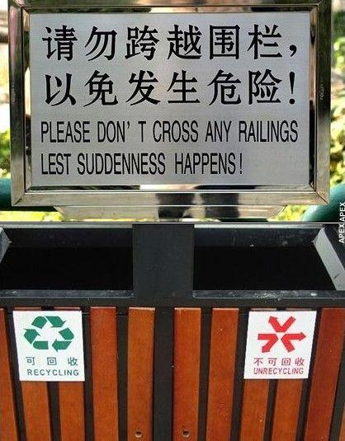
Programming as translation
But we know translation is a lossy process.
So why are we doing two translations?

Slide 51
Programming as translation
Natural Language: expressive and readable, but verbose and imprecise.
Math: concise and precise, but not readable or executable.
Programming languages: precise and executable, but verbose and not readable.

Slide 52
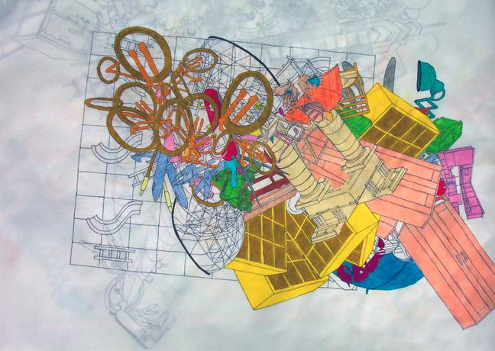
Programming as translation
Conciseness is the killer attribute of math notation, because of "chunking".
http://gregstewartsite.org/images/chunking-2006.jpg

Slide 53
Programming as translation
"More powerful programming languages make programs shorter. And programmers seem to think of programs at least partially in the language they're using to write them. The more succinct the language, the shorter the program, and the easier it is to load and keep in your head."
Paul Graham, "Holding a Program in One's Head," 2007.

Slide 54
Programming as translation
Natural Language: expressive and readable, but verbose and imprecise.
Math: concise and precise, but not readable or executable.
Programming languages: precise and executable, but verbose and not readable.

Slide 55
Programming as translation
Natural Language: expressive and readable, but verbose and imprecise.
Math: concise and precise, but not readable or executable.
Python: expressive, readable, concise, precise, and executable.

Slide 56
Programming as translation
Natural Language: expressive and readable, but verbose and imprecise.
Math: concise and precise, but not readable or executable.
Python: expressive, readable, concise, precise, and executable.

Slide 57

Thinking in Python
http://en.wikipedia.org/wiki/Bayesian_inference

Slide 58
Thinking in Python
class Suite(Pmf):
"""Map from hypothesis to probability."""
def update(self, data):
for hypo in self: like = self.likelihood(data, hypo) self[hypo] *= like
self.normalize()

Slide 59
Thinking in Python
class Suite(Pmf):
"""Maps from hypothesis to probability."""
def update(self, data):
for hypo in self: like = self.likelihood(data, hypo) self[hypo] *= like
self.normalize()

Slide 60
The point?
1) Programming as a way of understanding is the basis of my project, Think X (for all X).

Slide 61
The point?
2) Programming is a pedagogic wedge.
Once you learn to program, you can use it as a tool to learn everything else.

Slide 62
The point?
3) Which raises a question:
Most students learn math notation in grade school.
They spend almost 20% of their educational lives on it.
And roughly 0% on programming.

Slide 63
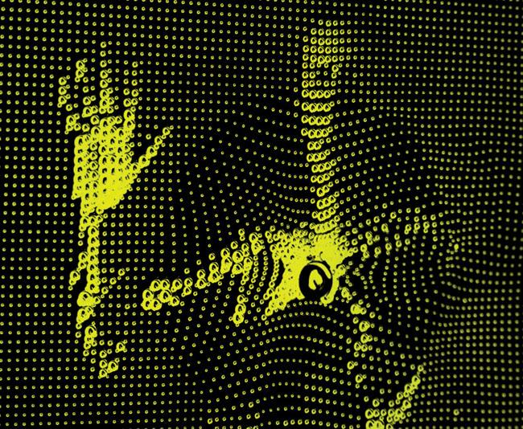
The point?
What if the next generation spent as much time programming as we spent on math?
http://www.flightphase.com/main_wp/expanded-media/disruption
Notes:
I speculate that they will think differently from us, fail with some problems that lend themselves to mathematical solutions, and then blow the doors off a number of problems that have not yielded to that toolkit.

Slide 64
The point?
I speculate:
They will think differently.
They might fail at some problems.
But they might solve problems that have not yielded to the traditional toolkit.

Slide 65
Thanks!
PyCon Taiwan 2013
Albert Chun-Chieh Huang

Slide 66
Comments? Questions?
Hint: ask me why there's a parrot on the cover of Think Python.

